Slide 1



How can we leverage content management systems to create more accessible digital experiences?
Lindsay Silver
October 2024
Notes:
Good afternoon! I know post lunch, pre afternoon break
And I’m not going to make it easy! This talk gets pretty technical – we’ll look at code examples and dive deep on some technical and design issues. But hopefully you’ll find it interesting too
A tiny bit about me – I’m an English major turned web developer. Learned about accessible coding pretty early on in my web career and never could let it go so I found myself a full time gig where I could focus on accessibility all the time and never hear the phrase “there isn’t time for accessibility OR the client won’t pay for it”. I’m really passionate about accessisbility in the physical and digital world and am so grateful to get to do this as my job and hopefully make digital experiences better for everyone regardless of ability. Discliamer: The opinions I express today are my own and not those of T-Mobile.

Slide 2
Slides: bit.ly/
Notes:
read twice

Slide 3



Goal
Show how to achieve accessibility for a dynamic & complex website that uses a content management system (CMS).
Notes:
if you dont consider interplay between cms and accessibility, then end solution won't be fully accessible

Slide 4



Agenda
What is a Content Management System (CMS)?
Setting up a Framework
Examples:
Card Image
Call to action link
Strikethrough text
Takeaways

Slide 5
What is a Content Management System (CMS)?

Slide 6
What is a Content Management System (CMS)?
A content management system allows users to author and publish content to a website through a graphical interface.
They do not have to have knowledge of coding.
Notes:
What is a CMS? A content management system allows users to author and publish content to a website through a graphical interface. They do not have to have knowledge of coding.
For example, WordPress became famous as a CMS that allowed users to create blogs simply and easily, and now allows for the creation of very complex websites.
Also drupal, wix, Squarespace, Joomla, etc
I have worked with CMS as both a dev and accessibility consultant and these examples are taken from that experience.

Slide 7
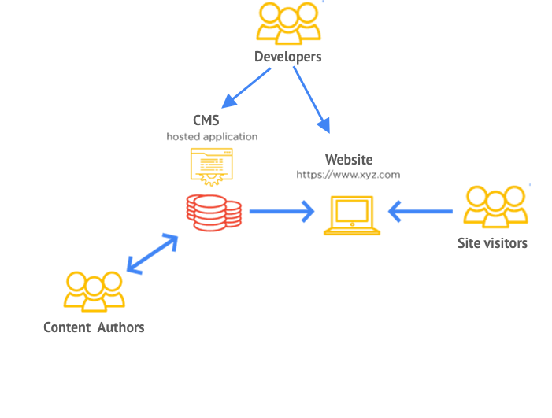
How Does a CMS Work?
Adapted from https://www.pixelmattic.com/wordpress-marketing/getting-started-with-wordpress/

Slide 8

There are Many People Involved in a Website that Uses a CMS
A lot of hands making the “quilt” of any given website
Notes:
Image taken from https://istockphoto.com%2Fphotos%2Fwomen-quilting&psig=AOvVaw0fLNi5PKKY5qiTZGOXPKeW&ust=1727311399802000&source=images&cd=vfe&opi=89978449&ved=0CBQQjRxqFwoTCIDQz8bu3IgDFQAAAAAdAAAAABAE
Women working together
Basting quilt

Slide 9
CMS Authorable Fields
We can create specific fields for certain pieces of text or other content that we want to be able to control through a CMS
Notes:
We can create specific fields for certain pieces of text or other content that we want to be able to control through a CMS

Slide 10
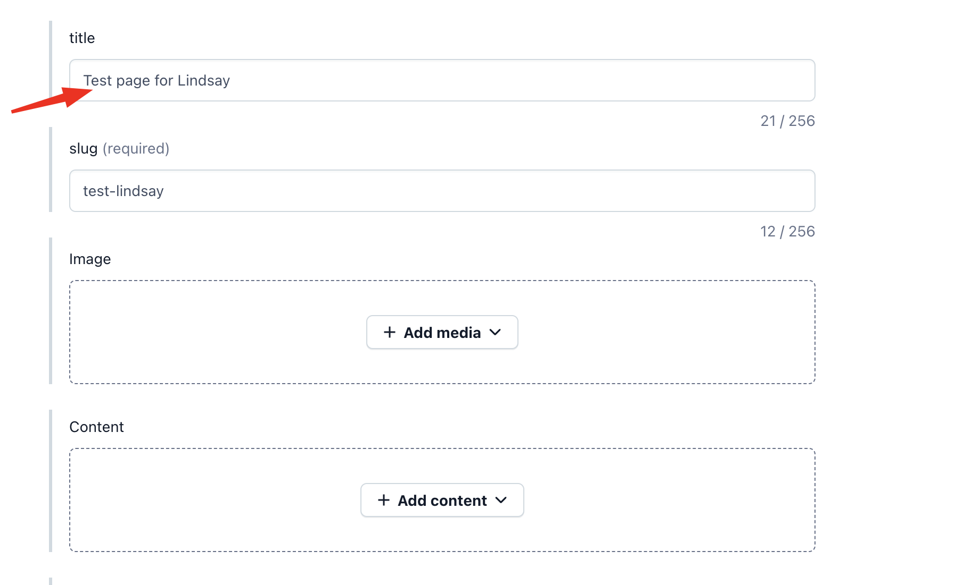
CMS Authorable Fields - Heading
Notes:
Contentful cMS – threw together a react/contentful framework that I’ve used for personal projects in the past
For example - for a heading we want a site visitor to see:
– content author, they add text heading for a page
- Developer – they code the logic to pull the text from the CMS for an hTMl heading that is dynamic..

Slide 11
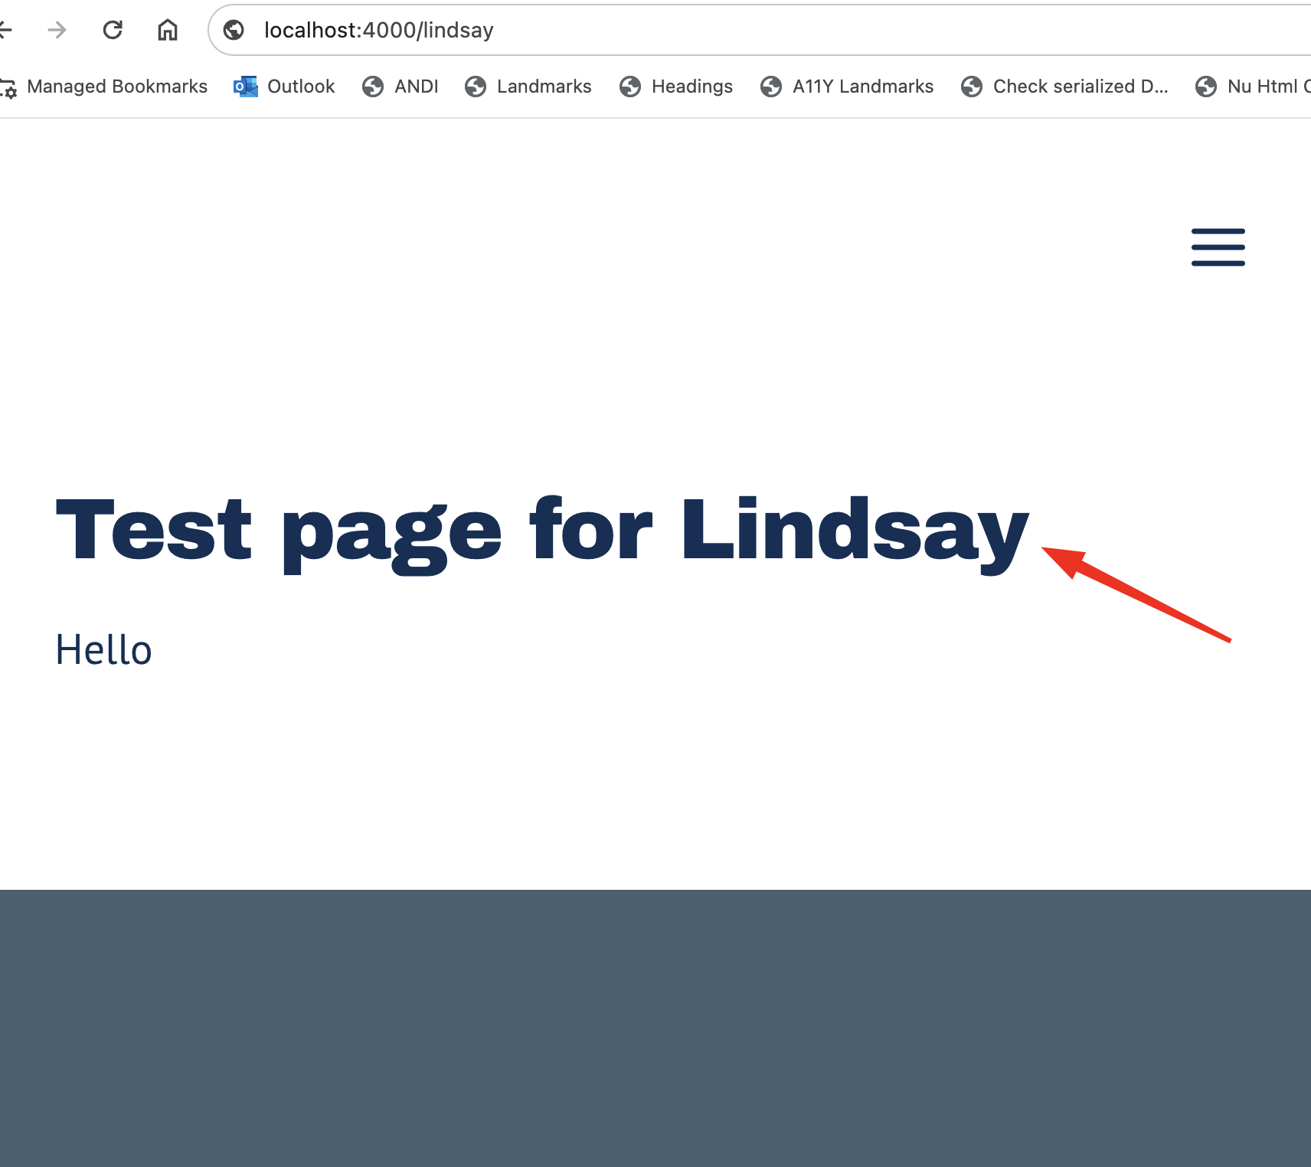
CMS Authorable Fields - Heading
Notes:
For example - for a heading we want a site visitor to see:
– content author, they add text heading for a page
- Developer – they code the logic to pull the text from the CMS for an hTMl heading that is dynamic..

Slide 12
CMS: What else can be authorable?
You may be able to use your CMS to author most of the aspects of your web pages – this includes text, images, links, and metadata that helps Search Engine Optimization (SEO) ratings.
Notes:
Now that we’ve seen the heading example, what else can be authored/authorable through a CMS?
You may be able to use your CMS to author most of the aspects of your web pages – this includes text, images, links, and metadata that helps Search Engine Optimization (SEO) ratings.

Slide 13
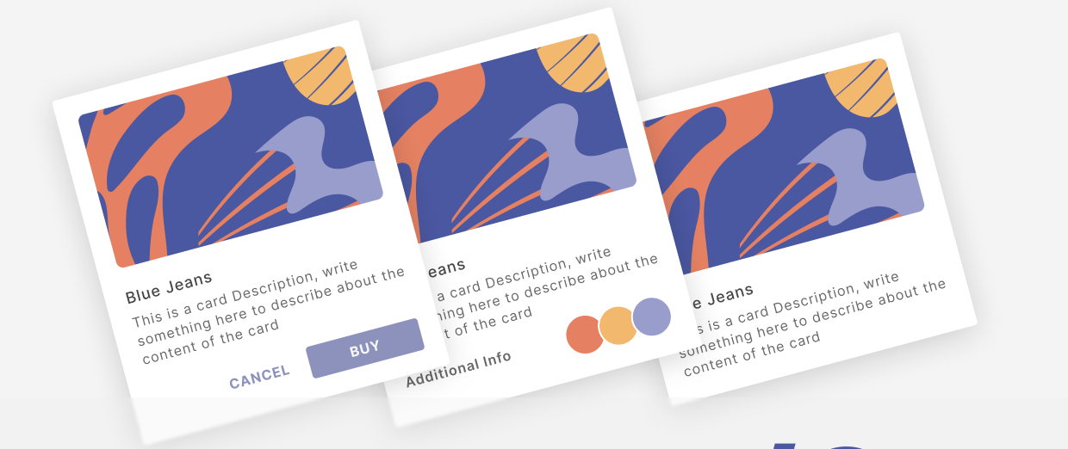
Card: What can be authorable?
Could be authorable:
Image
Heading
Description
Call to action
Often not authorable:
Colors
Layout
HTML
Notes:
Just depends on your team, what CMS you are using, the level of customization available.

Slide 14
Framework
Notes:
Let’s talk about framework I will apply to examples in talk

Slide 15
Problem to solve:
A CMS makes achieving accessibility more complex
Notes:
What was the problem, why did I create this framework?
A CMS makes achieving accessibility more complex (an experience that can be accessed by everyone)
Once you have content authors providing content, we must also ensure all the content is accessible – so you can’t just upload an image alone, you need to allow for a way to have alternate descriptions of the images for people who cannot see.

Slide 16



Problem to solve:
A CMS makes achieving accessibility more complex
Notes:
now with a complex, CMS-driven website, we have technical complexities, constraints, and human error that arise and can cause problems for accessibility
People working on quilt – cms, human error
Technical complexities – fabric, size of quilt
Design constraints – color, style

Slide 17
Framework:
Weighs WCAG, accessibility best practices, and technical constraints
Notes:
For features that are going to supplement content through a CMS, the Framework is a thought process to problem solving how to make those components accessible. They are questions you can ask.
Framework weighs WCAG requirements, accessibility best practices, and technical constraints to plan for and incorporate accessibility into CMS feature development and the day-to-day maintenance of a dynamic website.

Slide 18
Accessibility Framework: WCAG and Best Practices
#1 What requirements are needed for accessibility for the component in question?
Refer to MagentaA11y and WCAG 2.2 AA
Notes:
Component by component application / feature by feature (should be small, granular)
And again, this is all about content we are supplying through a CMS – if you aren’t using a CMS to add the content, then you can address this without the framework!

Slide 19
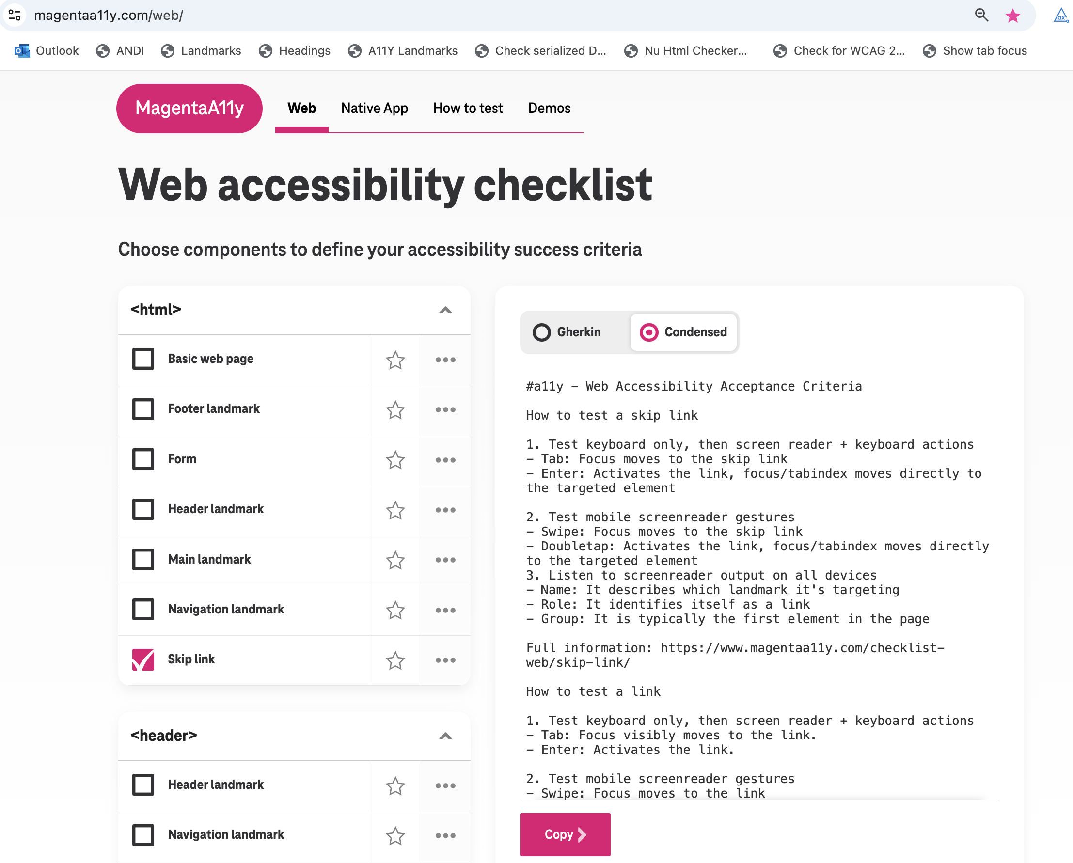
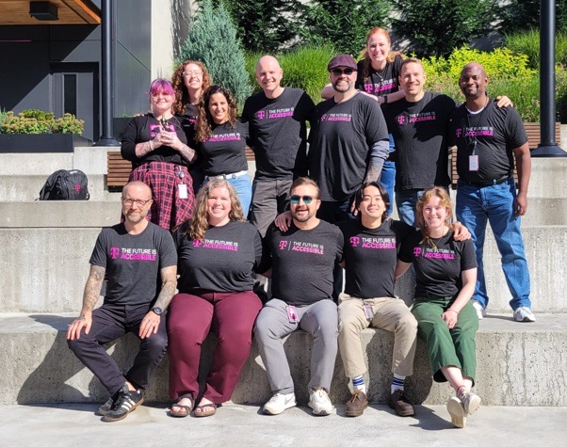
Magentaa11y.com
Notes:
Created by team at TMO
Magentaa11y
Good foundation for definining testable requirements for accessible componetns
Also information about building components accessibly
Our testing information is right now only about keyboard and desktop/mobile screen reader, but obviously depending on your team you will also want to consider other assistive tech
Always more custom stuff
There are common components, acs - not conclusive, all encompassing, it’s a starting point to functional requirements
TODO – photo of ARC team here

Slide 20
Accessibility Framework: Design or Dev Limitations
#2 What are the design and / or technical limitations?
What is design pushing for?
What is the technical context of this component?
Is it custom?
Can it be used multiple times?
Is this component used in other ways?

Slide 21
Accessibility Framework: To hard code or use a CMS?
#3 Should the accessibility features be hard coded on the frontend or coming from a CMS?
Hard coding in this presentation will refer to developers coding only using the frontend of the website, rather than the CMS.
Notes:
Again for a feature that has content coming from the CMS, do we need to supplement accessibility in the CMS too? Or hard code?
To hard code or use the CMS?
What is hard code?
Hard coding in this presentation will refer to developers coding only using the frontend of the website, rather than the CMS.
Means that developer controls and it is unchangeable without their intervention. Cannot be altered through the CMS

Slide 22
Accessibility Framework: To hard code or use a CMS?:
#3 Should the accessibility features be hard coded or coming from a CMS?
Pros
Flexibility of CMS authoring
Stability of hard coding
Notes:
Go through pros and cons
Iteration – once they develop, there might be other considerations, ways things have to be done

Slide 23
Accessibility Framework: To hard code or use a CMS?
#3 Should the accessibility features be hard coded or coming from a CMS?
Cons
CMS introduces potential for more human error
Hard coding can become stale, incorrect if undocumented
Don’t be afraid of iteration.
Notes:
Go through pros and cons
Iteration – once they develop, there might be other considerations, ways things have to be done

Slide 24
Recap Accessibility Framework
What requirements are needed for accessibility for the component in question?
What are the design and / or technical limitations?
Should the accessibility features be hard coded on the frontend or coming from a CMS?
Notes:
Recap for this framework and how using it can help with problem solving accessibility and including accessibility with a complex, CMS-driven website

Slide 25
Examples

Slide 26
Lindsay’s Coffee Website
Notes:
I will be using examples taken from my fake coffee website that I spun up – there is a codepen I will have a link for

Slide 27
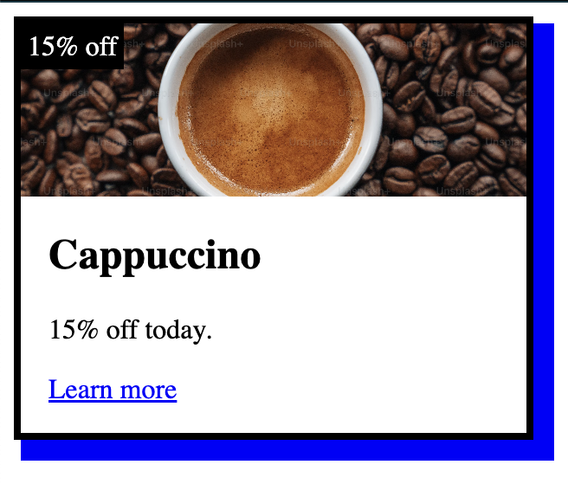
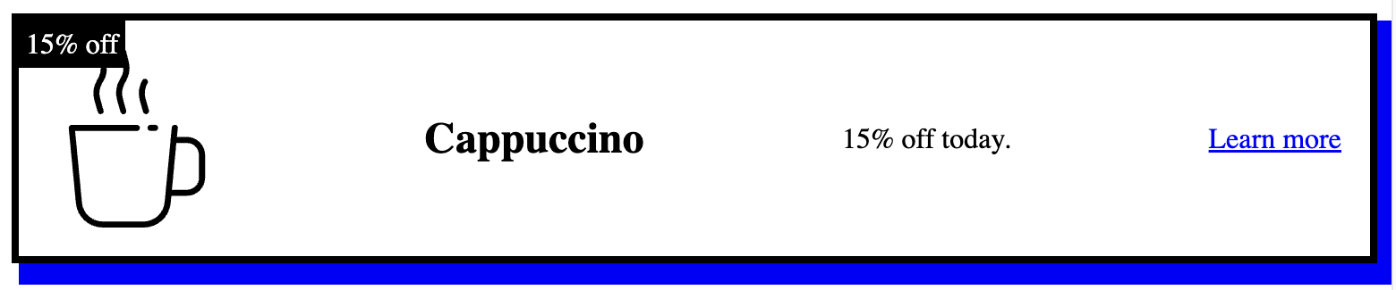
Lindsay’s Coffee Website
Codepen: https://codepen.io/silverli/pen/GRbxJxW
Notes:
I will be using examples taken from my fake coffee website that I spun up – there is a codepen I will have a link for

Slide 28
Card Image

Slide 29
Accessibility requirements: Card Image
#1 What requirements are needed for accessibility for the component in question?
Refer to MagentaA11y and WCAG 2.2 AA
Test screen reader:
Name: The content of the image alt text is clear.
Role: It identifies its role as an image or graphic.

Slide 30
Design or Dev Limitations: Card Image
#2 What are the design and / or technical limitations?
Notes:
Using dynamic HTML picture element, they are able to change out which logo or image for the card is rendered at desktop or mobile breakpoints.
The icon is less important, we want to mark it as decorative on mobile
So we'll do a image alternative text desktop breakpoint of images use cases

Slide 31
To hard code or use a CMS?: Card Image
#3 Should the accessibility features be hard coded on the frontend or coming from a CMS?
Notes:
Again remember: This question is about the accessibility of content being supplied to a CMS. All these components are using CMS to add the content, so this question is how we achieve accessibility for that content.
The images could be changing all the time based on what's new to the customer.
The images and their alternative text will be authorable through the CMS.

Slide 32
To hard code or use a CMS?: Card Image
#3 Should the accessibility features be hard coded on the frontend or coming from a CMS?
Use a CMS! AND a little bit of hard coding

Slide 33
To hard code or use a CMS?: Card Image
#3 Use a CMS:
alt text for desktop images:
"Cappuccino in a white cup surrounded by coffee beans"
alt text for mobile images:
"" (marked as decorative)

Slide 34
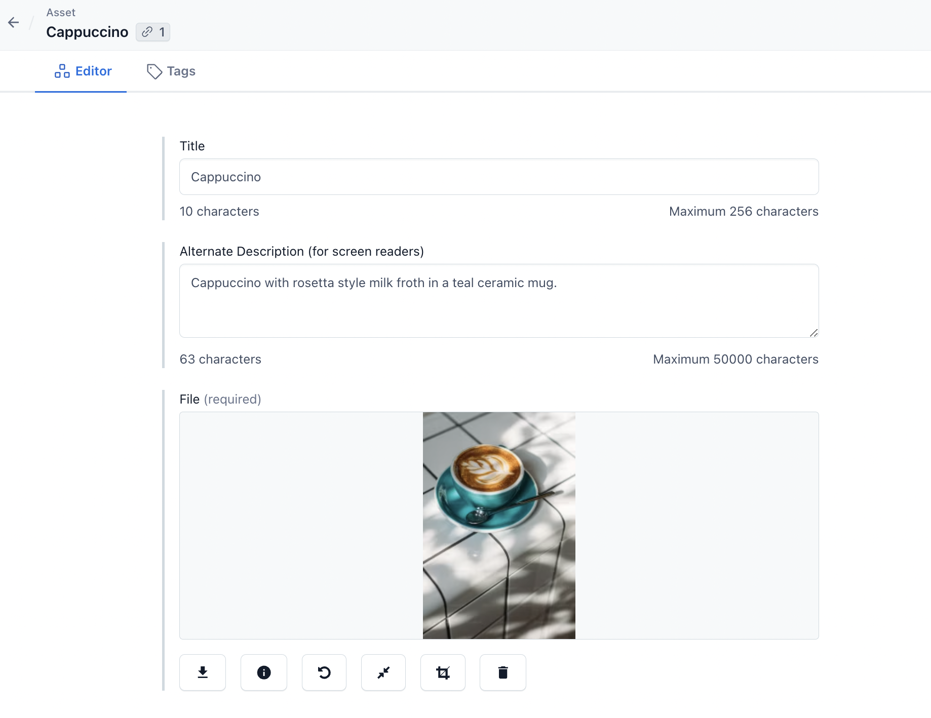
CMS Authorable Fields – Card Image
Notes:
Some fields will be authorable through the CMS, and some things will be hard coded into the page or coming from a non-authorable source (API data)

Slide 35
To hard code or use a CMS?: Card Image
#3 Hard coding logic:
<picture
<source media="(min-width: 900px)" srcset="desktop-img.png" />
<img
src="mobile-img.png"
alt={isMobile ? "" : image.desktop.alt} />
</picture>
Notes:
Using the picture element to render different images at different breakpoints
Mobile will render as "" empty string or could also do null to mark icon as decorative
Ternary operator – used ES6? -mention

Slide 36
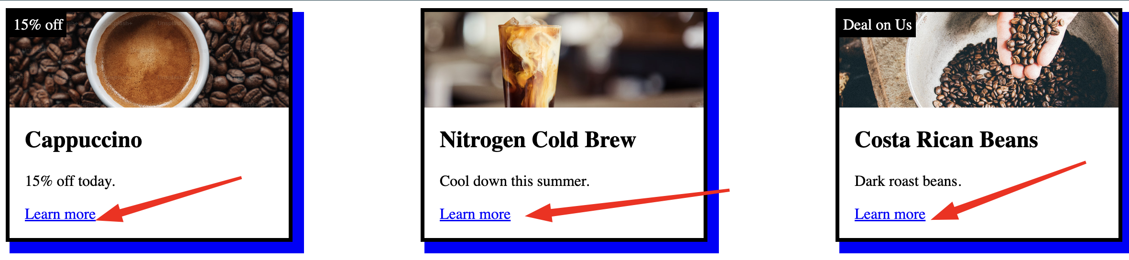
Card Call to Action (CTA)/ Link

Slide 37
Accessibility requirements: Card CTA
#1 What requirements are needed for accessibility for the component in question?
Refer to MagentaA11y and WCAG 2.2 AA

Slide 38
MagentaA11y criteria: Card CTA
Test keyboard-navigation:
Tab: Focus visibly moves to the link.
Enter: Activates the link.
Test screen reader:
Name: Its purpose is clear
Role: It identifies itself as a link

Slide 39
WCAG 2.4.4 Link Purpose: Card CTA
TLDR; Link purpose must be clear.
The purpose of each link can be determined from the link text alone or from the link text together with its programmatically determined link context
Notes:
Having multiple "Learn more" links is a WCAG violation (2.4.4 Link Purpose) because it is very confusing to have links called the same thing going to different locations for users of screen readers. Also could be ok if Link was inside the same p tag as other text – aka programmatically determined link context but it's not in this case:
In HTML, information that is programmatically determinable from a link in English includes text that is in the same paragraph, list, or table cell as the link or in a table header cell that is associated with the table cell that contains the link.
Giving the Call to action link text more context

Slide 40
Design or Dev Limitations: Card CTA
#2 What are the design and / or technical limitations?
Notes:
Design wasn't amenable to changing visual link text to be unique

Slide 41
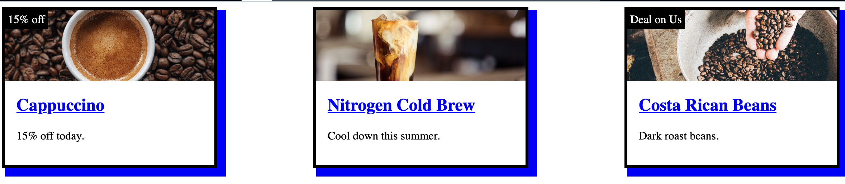
Ideal World
We could fix many accessibility problems by removing generic, same length link text and linking headings:
Notes:
Simpler
Works for cognitive, screen reader, voice control

Slide 42
Design or Dev Limitations: Card CTA
#2 What are the design and / or technical limitations?
Notes:
Design wasn't amenable to changing visual link text to be unique

Slide 43
To hard code or use a CMS?: Card CTA
#3 Should the accessibility features be hard coded on the frontend or coming from a CMS?

Slide 44
To hard code or use a CMS?: Card CTA
#3 Should the accessibility features be hard coded on the frontend or coming from a CMS?
Hard code.
Every situation is different, but many issues can arise when leaving appropriate accessible link text to content authors.
Notes:
I’ve seen issues relating to this in the past, but just depends on tech stack/team

Slide 45
To hard code or use a CMS?: Card CTA
#3 Hard coding logic with aria-labelledby:
<article class="card">
<h2 id="cappuccinoHeading">Cappuccino</h2>
…
<a id="cappuccinoLink" href="/cappuccino" aria-labelledby="cappuccinoLink cappuccinoHeading">Learn more</a>
</article>
Notes:
Concatenated aria-labelledby with self-referential Id

Slide 46
To hard code or use a CMS?: Card CTA
#3 If you did go CMS route:
CMS field for call to action links for screen reader users:
”Learn more, Cappuccino "
”Learn more, Nitrogen cold brew "
”Learn more, Costa Rican beans"
Notes:
Unfortuntaley, any chance we get to programmatically define accessibility instead of relying on people in a CMS - it's been more sturdy.
At TMO, we have content author trainings on how to add appropriate context CTA text. Our rule is that first must come the visual text, and then the context clue (ideally using a heading above to help).
Recommendd format is “visible label, {appended extra content such as heading, body, nearby}”
Label in name issue is created when content authors do this wrong- visible label does not completely match a string in the accessible name

Slide 47
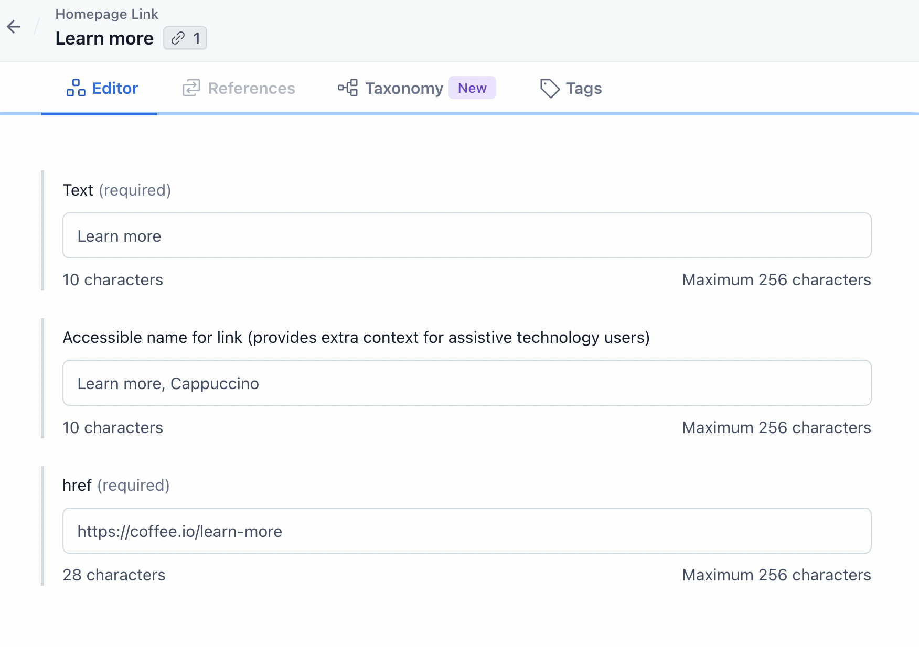
CMS Authorable Fields – Card CTA
Notes:
Some fields will be authorable through the CMS, and some things will be hard coded into the page or coming from a non-authorable source (API data)

Slide 48
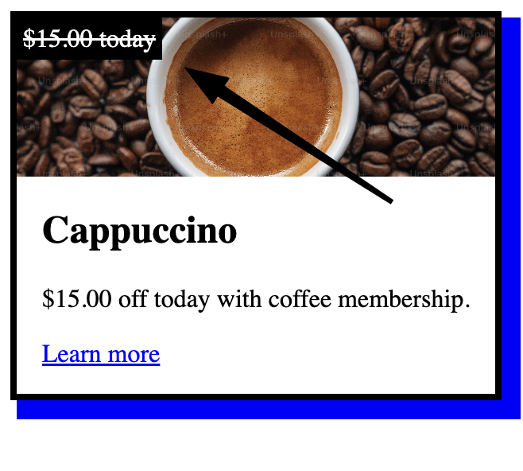
Card Strikethrough Text

Slide 49
Accessibility requirements: Strikethrough Text
#1 What requirements are needed for accessibility for the component in question?
Refer to MagentaA11y and WCAG 2.2 AA
Test screen reader:
Name: The content makes sense and is in logical order

Slide 50
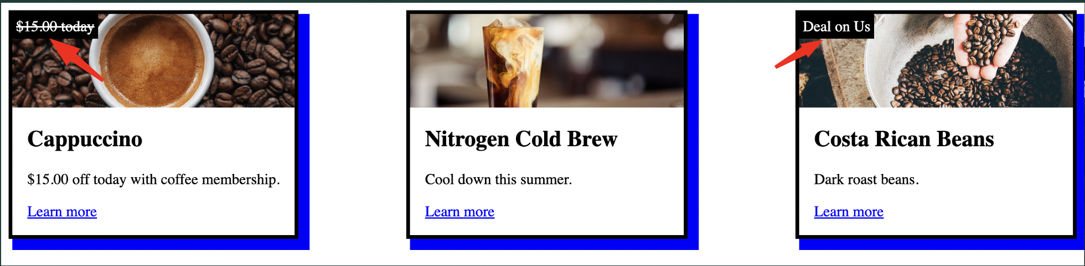
Design or Dev Limitations: Strikethrough Text
#2 What are the design and / or technical limitations?
Notes:
Strikethrough HTML does not announce to screen reader. – bold, italics, strikethrough can be a setting on in certain places (by default voiceover, nvda don’t announce)
- Strikethrough formatting might be announced depending on verbosity settings
So we need Equivalent text for strikethrough meaning that cannot be conveyed to screen reader as it is styling only
This field could be used in different contexts, pricing. Does not always have strikethrough text through entire area

Slide 51
To hard code or use a CMS?: Strikethrough Text
#3 Should the accessibility features be hard coded on the frontend or coming from a CMS?
Notes:
Strikethrough text equivalent will need to be present and authored – could be hard coded, but this was possible

Slide 52
To hard code or use a CMS?: Strikethrough Text
#3 Should the accessibility features be hard coded on the frontend or coming from a CMS?
Use a CMS.
Notes:
Strikethrough text equivalent will need to be present and authored – could be hard coded, but this was possible

Slide 53
To hard code or use a CMS?: Strikethrough Text
#3 Use a CMS:
"Was"
"Value of"
"You are saving"==Winner!
Notes:
Strikethrough text equivalent will need to be present and authored – could be hard coded, but this was possible
Had to think through copy that would make sense in all scenarios
"Was"
"Value of"
"You are saving"==Winner!
"you are saving $15.00 today"

Slide 54
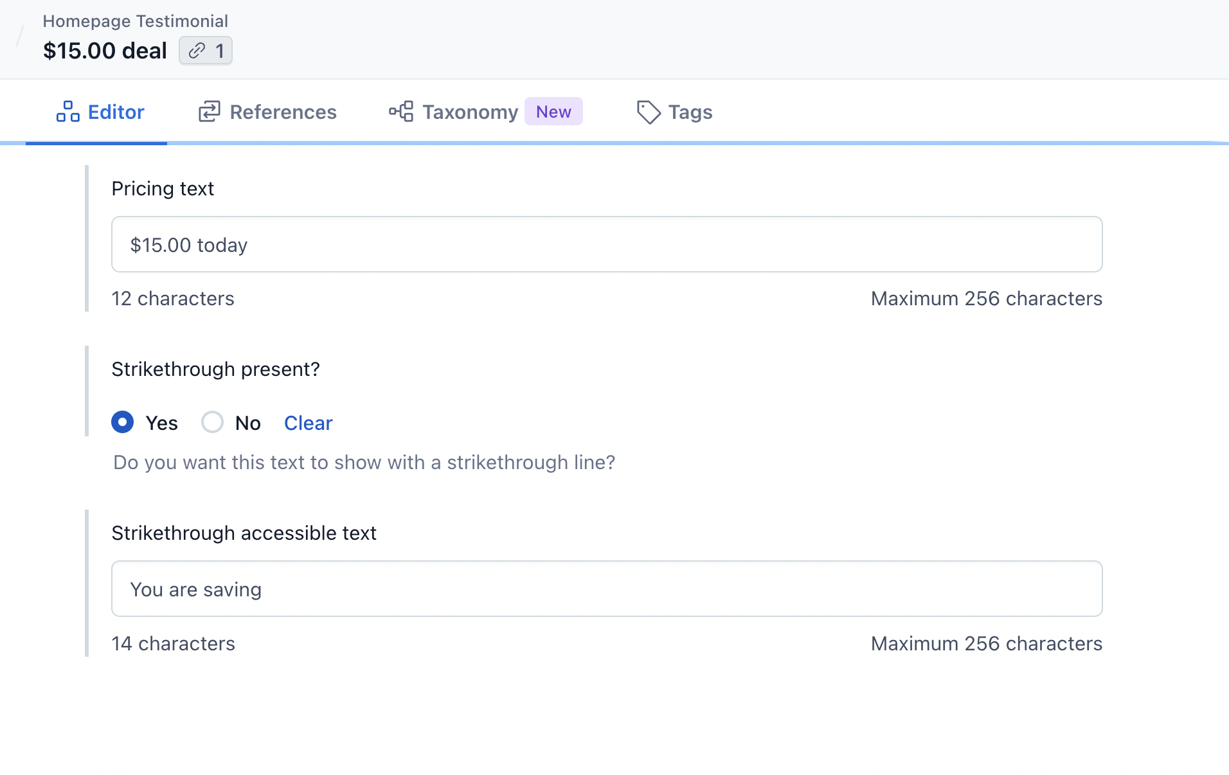
CMS Authorable Fields – Strikethrough Text
Notes:
Some fields will be authorable through the CMS, and some things will be hard coded into the page or coming from a non-authorable source (API data)

Slide 55
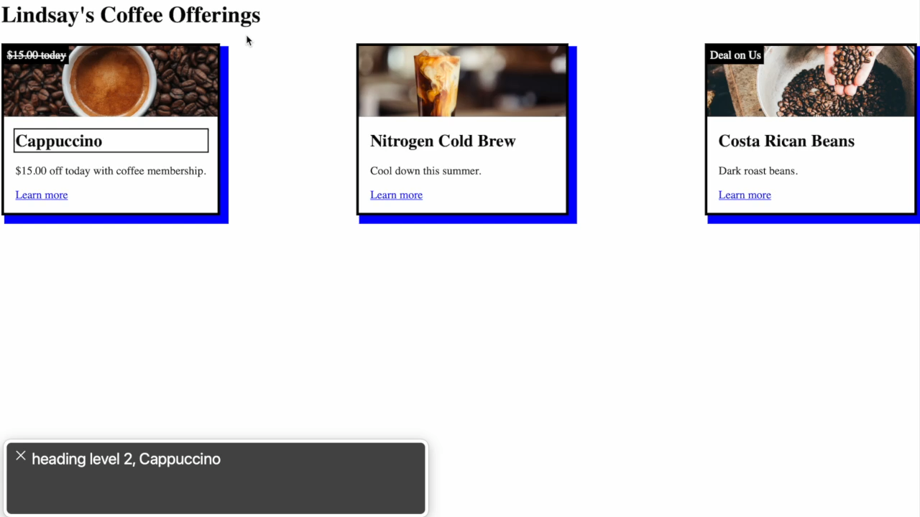
To hard code or use a CMS?: Strikethrough Text
Recording before accessibility considered:

Slide 56
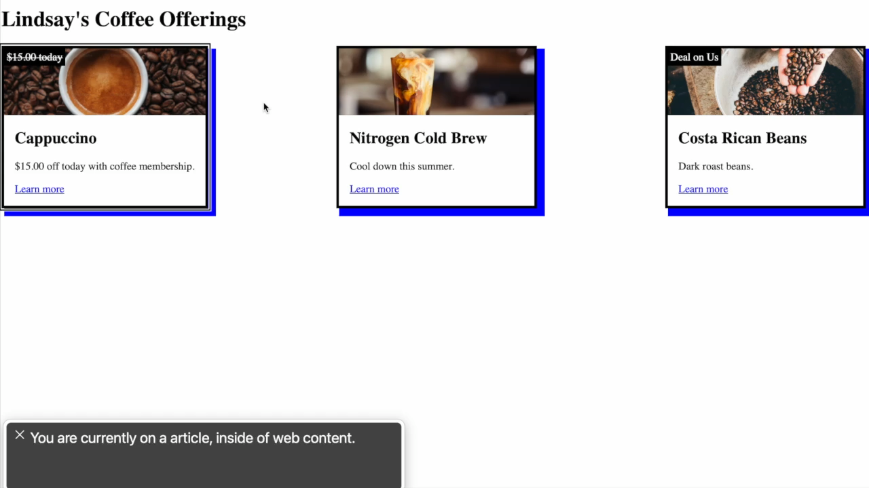
To hard code or use a CMS?: Strikethrough Text
Recording after accessibility considered:

Slide 57
Recap & Takeaways

Slide 58
Problem to solve:
A CMS makes achieving accessibility more complex

Slide 59
Recap Accessibility Framework
What requirements are needed for accessibility for the component in question?
What are the design and / or technical limitations?
Should the accessibility features be hard coded on the frontend or coming from a CMS?

Slide 60
Additional Takeaways
Rely on your accessibility subject matter expert when possible.
Use the framework to help understand whether a CMS should be used or not to ensure accessible outcomes
Document all the authorable fields, especially for accessibility
Do spot checks - especially during and after launch and when new features are created
Notes:
Rely on and include your accessibility subject matter expert when possible in design and feature level discussions.
Use the framework to help understand whether a CMS should be used or not to ensure accessible outcomes
Hard code vs cms
Stability vs flexbility
Document all the authorable fields, especially for accessibility
Ask for clear hint text to accompany the authorable fields
Do spot checks - especially during and after launch and when new features are created
Again, I hope this talk and case study of benefits hub was interested, showed how ensuring accessibility is possible, if also difficult with complex, CMS-driven websites.
I hope the framework is helpful to think about how to assess and implement features with CMS.
Also hope this has shown how a CMS can yield inclusive outcomes despite design, technical, and content authoring constraints.

Slide 61
With the flexibility of a CMS, we can achieve an accessible, inclusive digital experience.
Notes:
For content supplied through a CMS
Concept – single design – works for as many people as possible
(Even if it's a bit different content-wise – we are still striving for equity)
Again, in case of CTA..
Inclusive – works for everybody
In the case of the CTA, couldn’t achieve same visual
Or even strikethrough

Slide 62

Notes:
Concept – single design – works for as many people as possible
(Even if it's a bit different content-wise – we are still striving for equity)
Again, in case of CTA..
Inclusive – works for everybody
In the case of the CTA, couldn’t achieve same visual
Or even strikethrough

Slide 63


Thank you!
LinkedIn
Website
www.linkedin.com/in/lindsay-silver-1882b0b3
silverli.github.io

